Slide 1
Introduction to 8086 Microprocessor

Slide 2
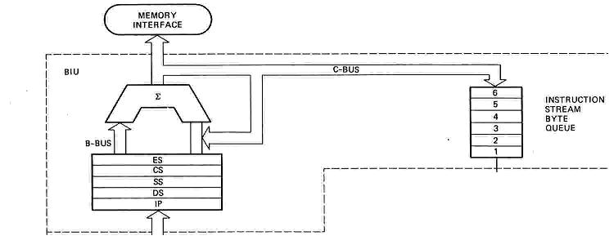
BUS INTERFACE UNIT (BIU)
Contains
6-byte Instruction Queue (Q)
The Segment Registers (CS, DS, ES, SS).
The Instruction Pointer (IP).
The Address Summing block (Σ)
‹#›

Slide 3
Instruction Queue
8086 employs parallel processing
When EU is busy decoding or executing current instruction, the buses of 8086 may not be in use.
At that time, BIU can use buses to fetch up to six instruction bytes for the following instructions
BIU stores these pre-fetched bytes in a FIFO register called Instruction Queue
When EU is ready for its next instruction, it simply reads the instruction from the queue in BIU

Slide 4
Pipelining
EU of 8086 does not have to wait in between for BIU to fetch next instruction byte from memory
So the presence of a queue in 8086 speeds up the processing
Fetching the next instruction while the current instruction executes is called pipelining.
BIU reset the Queue after a CALL or JUMP instruction, and then refill the Queue.

Slide 5
Memory Segmentation
8086 has a 20-bit address bus
So it can address a maximum of 1MB of memory
8086 can work with only four 64KB segments at a time within this 1MB range
A segment may be located anywhere in the memory
These four memory segments are called
Code segment
Stack segment
Data segment
Extra segment

Slide 6
Segmented Memory
Physical Memory
Code segment (64KB)
Data segment (64KB)
Extra segment (64KB)
Stack segment (64KB)
00000
Segments may be overlapped or non-overlapped
1 MB
FFFFF

Slide 7
Code Segment
Contains all the program instructions
Stack Segment
A section of memory set aside to store addresses and data while a subprogram executes
Data & Extra Segments
Used for storing data values to be used in the program

Slide 8
Segment Registers
hold the upper 16-bits of the starting address for each of the segments
The four segment registers are
CS (Code Segment register)
IP can be used as offset.
DS (Data Segment register)
BX,SI or DI can be used as offset.
SS (Stack Segment register)
SP and BP can be used as offset.
ES (Extra Segment register)
DI can be used as offset.

Slide 9
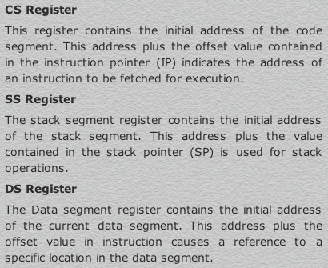
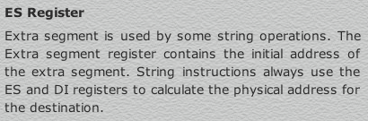
‹#›

Slide 10
Memory
1
Code Segment
3
4
Data Segment
Extra Segment
7
8
9
10
11
12
13
14
15
Stack Segment
00000H
CS
1000 0H
DS
4000 0H
ES
5000 0H
1MB Address Range
Starting Addresses of Segments
SS
F000 0H
FFFFFH

Slide 11
Instruction pointer & summing block
The instruction pointer register contains a 16-bit offset address of instruction that is to be executed next.
The IP always references the Code segment register (CS).
The value contained in the instruction pointer is called as an offset because this value must be added to the base address of the code segment, which is available in the CS register to find the 20-bit physical address.
The value of the instruction pointer is incremented after executing every instruction.
To form a 20bit address of the next instruction, the 16 bit address of the IP is added (by the address summing block) to the address contained in the CS , which has been shifted four bits to the left.

Slide 12

Intel
Memory Address Generation
The BIU has a dedicated adder for determining physical memory addresses
Offset Value (16 bits)
Segment Register (16 bits)
0 0 0 0
Adder
Physical Address (20 Bits)

Slide 13
Intel
Example Address Calculation
If the data segment starts at location 1000h and a data reference contains the address 29h where is the actual data?
2
9
Offset:
0 0 0 0 0 0 0 0 0 0 1 0 1 0 0 1
Segment:
0 0 0 1 0 0 0 0 0 0 0 0 0 0 0 0
0 0 0 0
Address:
0 0 0 1 0 0 0 0 0 0 0 0 0 0 1 0
1 0 0 1

Slide 14
The following examples shows the CS:IP scheme of address formation:
CS
34BA
IP
8AB4
Code segment
34BA0
Inserting a hexadecimal 0H (0000B)
with the CSR or shifting the CSR
four binary digits left
8AB4 (offset)
3D645
3 4 B A 0 ( C S ) +
8 A B 4 ( I P )
3 D 6 5 4 (next address)
44B9F
‹#›

Slide 15
Memory
Start of Code Segment
348A0H
00000H
1
Data Segment
3
4
Code Segment
Extra Segment
7
8
9
10
11
12
13
14
15
Stack Segment
IP = 4214H
Code Byte
38AB4H
MOV AL, BL
1MB Address Range
348A H
CS
0
IP
+
4214 H
Physical Address
38AB4 H
FFFFFH

Slide 16
Stack Segment (SS) Register Stack Pointer (SP) Register
Upper 16-bits of the starting address of stack segment is stored in SS register
It is located in BIU
SP register holds a 16-bit offset from the start of stack segment to the top of the stack
It is located in EU

Slide 17
Other Pointer & Index Registers
Base Pointer (BP) register
Source Index (SI) register
Destination Index (DI) register
Can be used for temporary storage of data
Main use is to hold a 16-bit offset of a data word in one of the segments

Slide 18
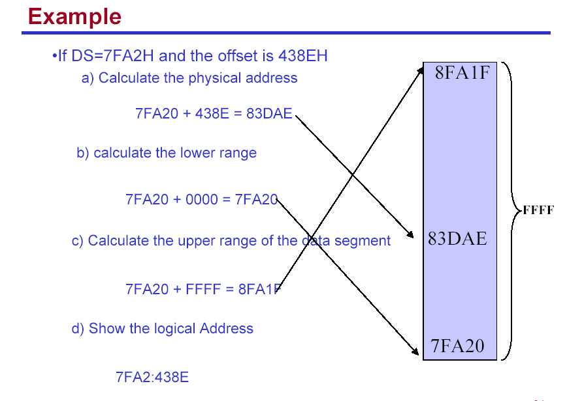

Slide 19
Your turn . . .
What physical address corresponds to the segment/offset address 028F:0030?
028F0 + 0030 = 02920
Always use hexadecimal notation for addresses.

Slide 20
Your turn . . .
What segment addresses correspond to the physical address 28F30h?
Many different segment-offset addresses can produce the linear address 28F30h. For example:
28F0:0030, 28F3:0000, 28B0:0430, . . .

Slide 21
The Code Segment
_{0H}
4000H
CS:
0400H
IP
0056H
4056H
CS:IP = 400:56
Logical Address
Memory
0400
0
Segment Register
Offset
Physical or
Absolute Address
+
0056
04056H
_{0FFFFFH}

Slide 22
The Data Segment
_{0H}
05C00H
DS:
05C0
05C50H
SI
0050
DS:EA
Memory
05C0
0
Segment Register
Offset
Physical Address
+
0050
_{0FFFFFH}
05C50H
Data is usually fetched with respect to the DS register.
The effective address (EA) is the offset.
The EA depends on the addressing mode.

Slide 23
The Stack Segment
_{0H}
0A00
0A000H
SS:
0A100H
SP
0100
SS:SP
Memory
0A00
0
Segment Register
Offset
Physical Address
+
0100
0A100H
_{0FFFFFH}
The offset is given by the SP register.
The stack is always referenced with respect to the stack segment register.

Slide 24
Segmentation
Advantages
Segment:offset approach is used rather than accessing memory directly with 20-bit addresses. In this approach, requires only 16-bit number to represent base address for segment and only 16-bit offset to access any location within the segment. This means that 8086 has to manipulate and store only 16-bit quantities instead of 20 bit quantities.
Multi tasking becomes easy. Because segmentation makes it easy to keep user’s programs and data separate from one another. Each user’s program can be assigned a separate set of logical segments for its code and data. To change from one user to another, the CPU has to reload the four segment registers with the segment base addresses assigned to the second user program.

